Slide 1
8th Grade Physics Forces

Slide 2
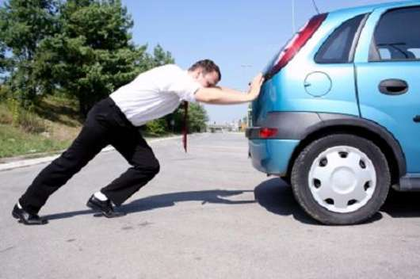
Force
A push or a pull.
Image: http://gurtej.net/files/2010/04/man-pushing-a-car.jpg; Definition: www.thefreedictionary.com

Slide 3
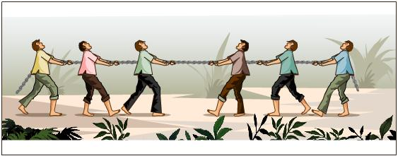
Balanced Force
30N
30N
The net force on an object is zero and the object’s motion does not change.
(object is not moving or has constant motion)
Image: http://image.wistatutor.com/content/force-laws-motion/balanced-force-example.jpeg; Definition: www.thefreedictionary.com

Slide 4
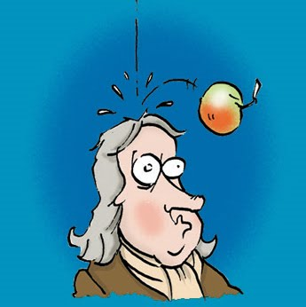
Gravity
A force that pulls objects together.
Gravity caused the apple to fall on Sir Isaac Newton’s head.
Image from: http://4.bp.blogspot.com/_Qe1wgxDiEdU/S0Sufn6jbSI/AAAAAAAAAJo/ak9Ty7SfZr0/s400/newton2.jpeg; Definition adapted from: Access Science glossary, page 316.

Slide 5
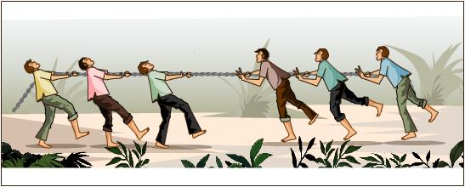
Unbalanced Force
50N
20N
The net force of an object is greater than zero which results in a change in the motion of the object.
Image: http://image.wistatutor.com/content/force-laws-motion/unbalanced-force-example.jpeg; Definition: www.thefreedictionary.com

Slide 6
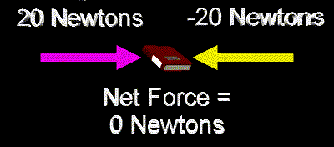
Net Force
The sum of all the forces acting on an object.
(The arrows that represent the forces are called Vectors)
Image: http://zonalandeducation.com/mstm/physics/mechanics/forces/netForce/netf3.gif; Definition: www.thefreedictionary.com

Slide 7
Force is measured in NEWTONS
The SI derived unit used to measure
force is a NEWTON. One Newton is
equal to the force needed to
accelerate a mass of one kilogram one
meter per second per second or 1 m/s².

Slide 8
Calculating Net Force
If forces are applied in the SAME direction, then the forces are ADDED together to find the Net Force.
or

Slide 9
Calculating Net Force
If forces are applied in the OPPOSITE direction, then the lesser force is SUBTRACTED from the greater force to find the Net Force and the object moves in the direction of the GREATER force.
or

Slide 10
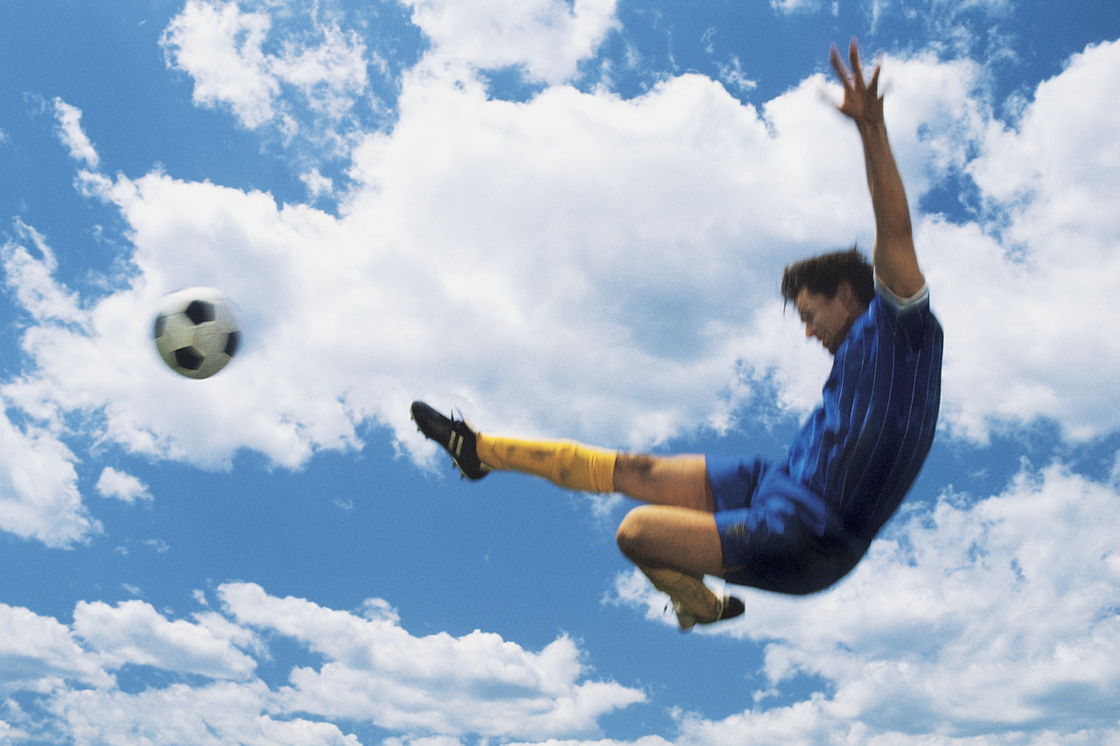
What is Motion?
Motion is:
A change in
position of an
object compared
to a reference
point

Slide 11
Forces affect Motion:
They can make objects start moving.
They can make objects move faster.
They can make objects move slower.
They can make objects stop moving.
They can make objects change direction.
They can make objects change shape.

Slide 12
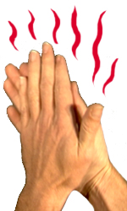
Friction
The force between objects that affects how easily they move past each other.
Image: http://www.mikecurtis.org.uk/images/friction.jpg; Definition: Access Science glossary, page 315.

Slide 13
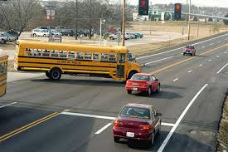
Friction affects Motion
Friction is a force that causes objects to slow down or stop
Image adapted from: http://sciencevault.net/11hscphys/84movingabout/pics/elevatedram.jpg; Definition: www.thefreedictionary.com

Slide 14
Videos
Physics of Skydiving
All about Forces and Gravity
Physics of Game programming
https://www.youtube.com/watch?v=ur40O6nQHsw
https://www.youtube.com/watch?v=ysrpUL8dASg
https://www.youtube.com/watch?v=Kt9OilEzwnk

Slide 15
Forces and biking
https://www.youtube.com/watch?v=WoTQDrzCqb0

